Slide 1
CAMERA AND SCENEGRAPHS
REAL TIME 3D GRAPHICS
Lecture 7
Dr. Pablo Casaseca
Senior Lecturer in Signal and Image Processing
Email: Pablo.Casaseca@uws.ac.uk

Slide 2
RT3D – Lecture 7
Creating a Camera
LookAt, First & Third Person Camera
Intro to Scene Graphs
Recommended Reading
Interactive Computer Graphics, sections 3.4, 4.3, Chapter 8
Reminder: CW 60% - Exam 40%

Slide 3
Frames
Up till now we have been manipulating the position of objects & the viewer in our scene by manipulating a matrix representing the ‘model-view’ matrix
This is awkward when manipulating many objects
Difficult to explicitly position multiple objects and the camera
Answer is to think of each element as existing within a particular frame

Slide 4
World Frame
Frame is used to map local co-ordinates to global (scene) co-ordinates
i.e. A model loaded from file will typically have geometry specified in relation to a local origin
The world frame provides a common frame for positioning individual entities
Instead of thinking of how each entity is positioned relative to each other, consider relative to a common world-frame
Keeping it simple: set origin of this frame to 0,0,0 and set principal axes to x,y,z

Slide 5
Actor Frame
Can also use frames to represent position and orientation of entities
An object’s frame stores the following information about the model in relation to the global origin & axis:
Location
Up vector (may be implicit)
Forward vector (again, may be implicit)
Can use 4x4 matrix or vector representations to store this data

Slide 6
Camera Frame
Again, a camera frame can be represented using set of three vectors (position, up, forward) or as a 4x4 matrix
As already seen, GLM (and deprecated OpenGL glu library) provide LookAt functions for generating the camera frame matrix from three vectors:
Eye vector: position of the camera
At vector: point camera is aimed towards
Up vector: up direction of camera

Slide 7
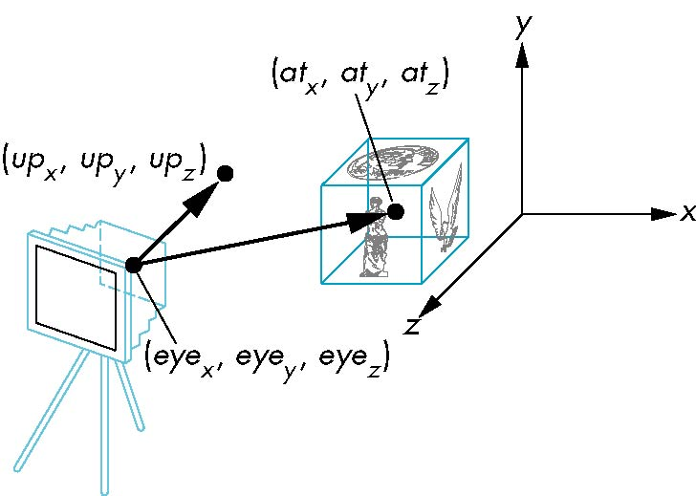
glm::lookat
LookAt(eye, at, up)

Slide 8
Camera
First person camera
Can rotate (i.e. not always pointing along Z!)
Forward movement is in direction of camera
Use variable to represent
Current position of player/camera
Current orientation (angle)
When rendering
Camera position gives EYE values
Need to calculate AT values

Slide 9
First Person Camera - Principles
Imagine a circle around the player position
Player is always looking ‘at’ a point on that circle – in direction of current facing
This will also be direction player moves when moving forward!
For simplicity, r = 1
circleX = sin α
circleZ = -cos α (-z is into screen)
α
x
z

Slide 10
First Person Camera
Putting together:
atX = eyeX + circleX; atZ = eyeZ + circleZ
Set height some arbitrary amount over the terrain/ground level
eyeY and atY need set. atY under user control if look up/look down enabled
Simply plug these values into your call to LookAt
When moving forward, simply add (scaled) circleX and circleZ to current x and z position values

Slide 11
First person camera
Function to move forward
glm::vec3 moveForward(glm::vec3 cam, GLfloat angle, GLfloat d) {
return glm::vec3(cam.x + d*std::sin(angle*DEG_TO_RAD),
cam.y, cam.z - d*std::cos(angle*DEG_TO_RAD));}
Update function
if ( keys[SDL_SCANCODE_W] ) eye= moveForward(eye, theta, 0.1f);
if ( keys[SDL_SCANCODE_S] ) eye= moveForward(eye, theta, -0.1f);
at = moveForward(eye,theta,1.0f);//after updating position

Slide 12
Moving sideways
Function to move sideways
glm::vec3 moveRight(glm::vec3 pos, GLfloat angle, GLfloat d) {
return glm::vec3(pos.x + d*std::cos(angle*DEG_TO_RAD),
pos.y, pos.z + d*std::sin(angle*DEG_TO_RAD));
}
Update function
if ( keys[SDL_SCANCODE_A] ) eye= moveRight(eye, theta, -0.1f);
if ( keys[SDL_SCANCODE_D] ) eye= moveRight(eye, theta, 0.1f);

Slide 13
Simple Third Person Camera
Same principle, but this time we always look at the player position
Instead of adjusting the point we are looking at, move the camera behind the player position…
Also need to modify y coordinate
Better and more complex solutions used in real games…
Over the shoulder camera (look in front & to side of player position)
Correct for obstacles – eg when player backed against a wall

Slide 14
3rd Person Camera Issues
Need to Correct for obstacles
eg when player backed against a wall
Check line from player head position to camera position
If this intersects any geometry, then the view is blocked
Adjust camera position accordingly
To temporary use first person view, or third person view from side or front
Or render intersecting geometry invisible or transparent

Slide 15
Hierarchical Models
Model in which objects are drawn relative to other objects
Ultimately, everything relative to some base or ‘root’ object

Slide 16
Trees and Graphs
Trees and Graphs as abstractions
Ways of thinking about how data is stored
Not necessarily a particular implementation
E.g. Tree for robot arm:
Shoulder
Upper Arm
Forearm
Hand
Finger
Finger
Finger
Finger
Finger

Slide 17
Tree nodes
Each node requires
Data for drawing contents
Data to position, scale and orient this node (and its children) relative to the node’s parent
Possibly as a single matrix
Pointers to children of the node and/or siblings

Slide 18
Tree Traversal
In principle any tree traversal will do
Depth first will minimise number of times transformation matrices need loaded/popped
i.e. will deal with all children of a parent node before moving to siblings of the parent
Parent transformation stays loaded for all children
each child may apply additional transformation, but these are popped before moving to siblings

Slide 19
Stack Based Traversal
E.g. Robot arm
Each part of arm requires pushing a new matrix onto stack
For each finger:
Push new matrix onto stack
Apply required transformations
Draw finger
Pop matrix off stack

Slide 20
A Tree Data Structure
Common data structure, comprised of a number of nodes each of which holds some data and which may contain links to additional nodes
Simplest form:
Each node has two nodes descending from it down to the bottom most nodes which have no nodes below them (the leaf nodes). A binary tree

Slide 21
Trees
The top most node is the root node
Child nodes – nodes below current node (towards leaf nodes)
Sibling nodes – nodes with common parent
Parent node – node above current node (towards root)
Implemented similarly to linked lists. A linked list is a tree with the constraint that each node can only have one child!

Slide 22
Node object using structure
typedef struct treenode
{
mat4 m;
void (*f)();
struct treenode *sibling;
struct treenode *child;
} treenode;

Slide 23
Generic Tree Traversal Function
void traverse( Node* node )
{
if ( node == NULL ) { return; }
mvstack.push( model_view );
model_view *= node->transform;
node->render( void );
if ( node->child ) { traverse( node->child ); }
model_view = mvstack.pop( void );
if ( node->sibling ) { traverse( node->sibling ); }
}

Slide 24
Drawing a Figure
Figure with Tree Traversal in Appendix A of ICG book (Section A.9)
And colour plate 27
This principle can be generalised to working with 3D scenes
Scene graphs

Slide 25
Skeletal Animation
Common since Unreal Engine 2
Create a skeleton for each model (or share a common one), where each vertex is positioned relative to a particular bone
Heavy set Ogre or small thief can share a common skeleton – scaled for different sizes of character with different meshes attached to each
More next week

Slide 26
Hierarchical Models
So far… using push and pop Matrix operations to create scene structure
BUT scene was entirely hard coded
We would like to be able to insert and remove elements from a tree for it to be more generally useful

Slide 27
OpenGL and Objects
OpenGL lacks an object orientation
Consider, for example, a green sphere
We can model the sphere with polygons or use OpenGL quadrics
Its color is determined by the OpenGL state and is not a property of the object
Defies our notion of a physical object
We can try to build better objects in code using object-oriented languages/techniques

Slide 28
Imperative Programming Model
Example: rotate a cube
The rotation function must know how the cube is represented
Vertex list
Edge list
cube data
Application
Rotate
results

Slide 29
Object-Oriented Programming Model
In this model, the representation is stored with the object
The application sends a message to the object
The object contains functions (methods) which allow it to transform itself
Application
Cube Object
message

Slide 30
C/C++
Can try to use C structs to build objects
C++ provides better support
Use class constructor
Can hide implementation using public, private, and protected members in a class
Can also use friend designation to allow classes to access each other

Slide 31
Cube Object
Suppose that we want to create a simple cube object that we can scale, orient, position and set its color directly through code such as
cube mycube;
mycube.color[0]=1.0;
mycube.color[1]= mycube.color[2]=0.0;
mycube.matrix[0][0]=………

Slide 32
Cube Object Functions
We would also like to have functions that act on the cube such as
mycube.translate(1.0, 0.0,0.0);
mycube.rotate(theta, 1.0, 0.0, 0.0);
setcolor(mycube, 1.0, 0.0, 0.0);
We also need a way of displaying the cube
mycube.render();

Slide 33
Building the Cube Object
class cube {
public:
float color[3];
float matrix[4][4];
// public methods
private:
// implementation
}

Slide 34
The Implementation
Can use any implementation in the private part such as a vertex list
The private part has access to public members and the implementation of class methods can use any implementation without making it visible
Render method is tricky but it will invoke the standard OpenGL drawing functions

Slide 35
Other Objects
Other objects have geometric aspects
Cameras
Light sources
But we should be able to have nongeometric objects too
Materials
Colors
Transformations (matrices)

Slide 36
Application Code
cube mycube;
material plastic;
mycube.setMaterial(plastic);
camera frontView;
frontView.position(x ,y, z);

Slide 37
Light Object
class light { // match Phong model
public:
boolean type;
boolean near;
float position[3];
float orientation[3];
float specular[3];
float diffuse[3];
float ambient[3];
}

Slide 38
Scene Descriptions
If we recall figure model, we saw that
We could describe model either by tree or by equivalent code
We could write a generic traversal to display
If we can represent all the elements of a scene (cameras, lights, materials, geometry) as C++ objects, we should be able to show them in a tree
Render scene by traversing this tree

Slide 39
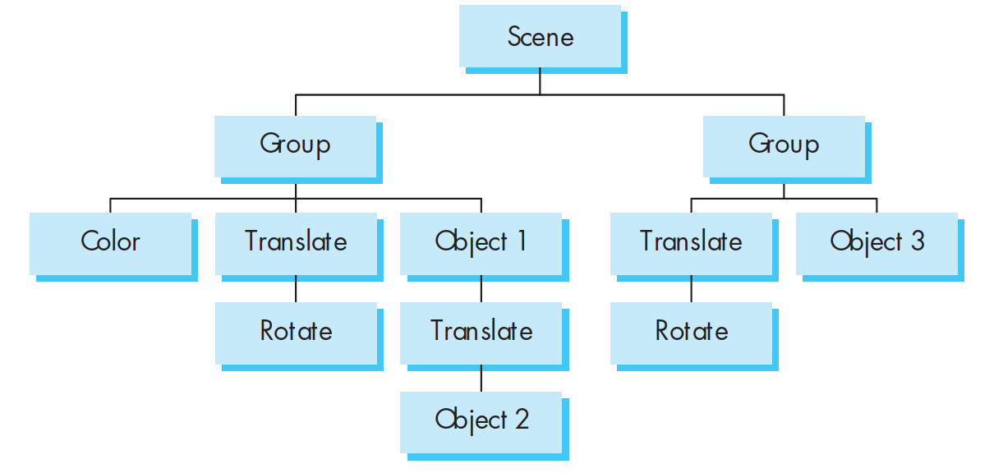
Scene Graph

